Slide 1

WOULD YOU FOLLOW YOU?
Drew Potthoff, CMAA
dpotthoff@marian.com
815.405.3821

Slide 2
WOULD YOU FOLLOW YOU?
https://www.youtube.com/watch?v=knYelygG1fI

Slide 3
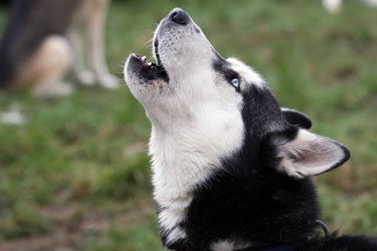
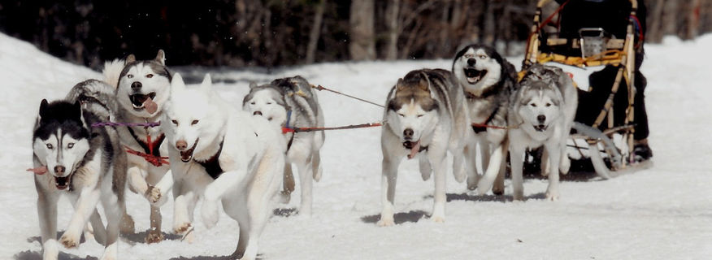
“One dog barks at a squirrel and a hundred dogs bark at the bark.”

Slide 4
PERCEPTION = REALITY
The way we perceive things may not always be reality.
May think we know the kind of leader we are
Challenge you to examine yourself today and every day

Slide 5
COUNT THE LETTER “F”
FINISHED FILES ARE THE RESULT
OF YEARS OF SCIENTIFIC STUDY
COMBINED WITH THE EXPERIENCE
OF MANY YEARS OF EXPERTS.

Slide 6
FINISHED FILES ARE THE RESULT
OF YEARS OF SCIENTIFIC STUDY
COMBINED WITH THE EXPERIENCE
OF MANY YEARS OF EXPERTS.

Slide 7
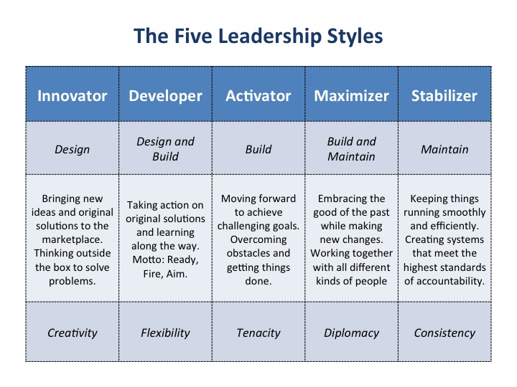
LEADERSHIP STYLES

Slide 8
The Good, The Bad, & The Ugly
https://www.youtube.com/watch?v=AFa1-kciCb4
“Seat of the Pants” Leader
  Leaders who can’t see it, probably won’t find it:
“Imposter” Leader:
  When leaders fail to lead themselves:
“Narcissistic” Leader:
  It’s all about themselves:
  Beware the know-it-all:
“Strategic” Leader
  Clearly Articulated Vision:
“Walk the Walk” Leader:
  Lead By Example
“Considerate” Leader:
  Listen
  Empathize

Slide 9
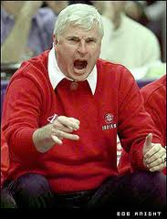
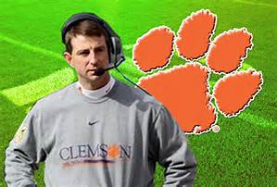
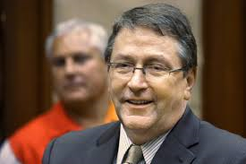
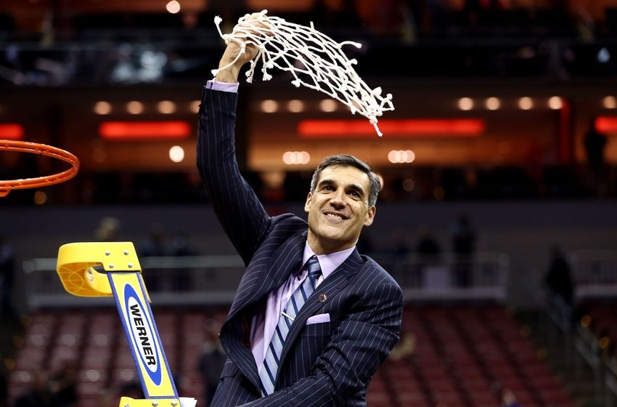
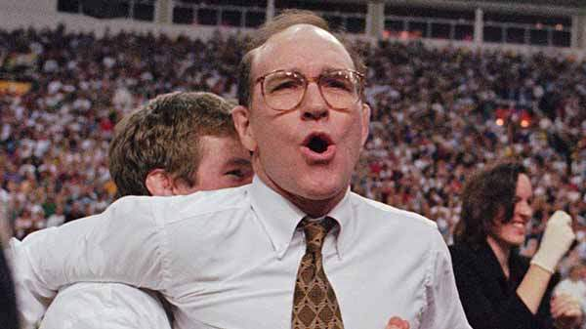

The Good, The Bad, & The Ugly

Slide 10
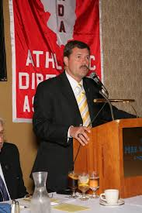
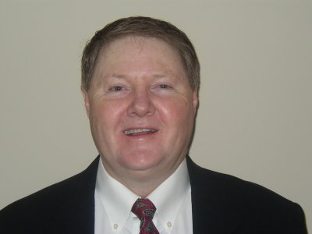
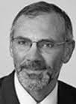
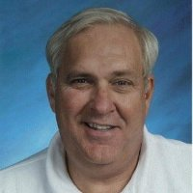
MANY HATS
COUNSELOR
MOTIVATOR
MEDIATOR
CHEERLEADER

Slide 11
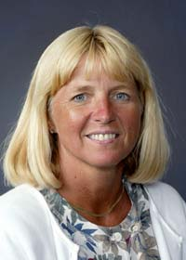
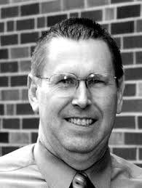
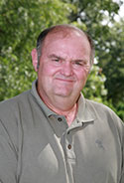
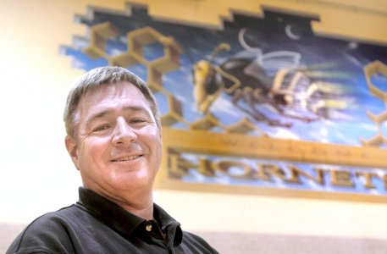
MANY HATS
LISTENER
PARENT
ADVISOR
MENTOR

Slide 12
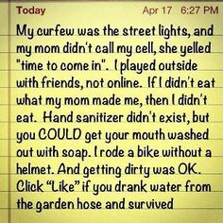
COACHING LANDSCAPE IS CHANGING
Support Coaches with Families
  Coaches Getting Out Earlier
  Coaching is Year Round (Like it or Not)
    Need to spend more time with their families
    Kids are growing up faster and there is less family time

Slide 13
SHOW SOME CHUTZPA
Leadership absent courage is a farce.
      Be Out Front – Fight For Your People
      Don’t Cave In To “That” Parent
      Time and Place
      “Script” Before Difficult Conversation
      Be Yourself

Slide 14



Summer Homework!
“Competitive Leadership”
by Brian Billick
“The Hard Hat”
by Jon Gordon
“You Win in the Locker Room First”
by Jon Gordon

Slide 15
WHAT CAN YOU CONTROL?
Every day you can control:
Your Effort
Your Energy
  Positive Energy- “Coach Up” Everyday
  Get out of the office
  Walk out to practice
  Be Visible – Before and AFTER Events

Slide 16
WHAT WILL YOU BE REMEMBERED FOR?
https://www.youtube.com/watch?v=eRaTpTVTENU

